Slide 1
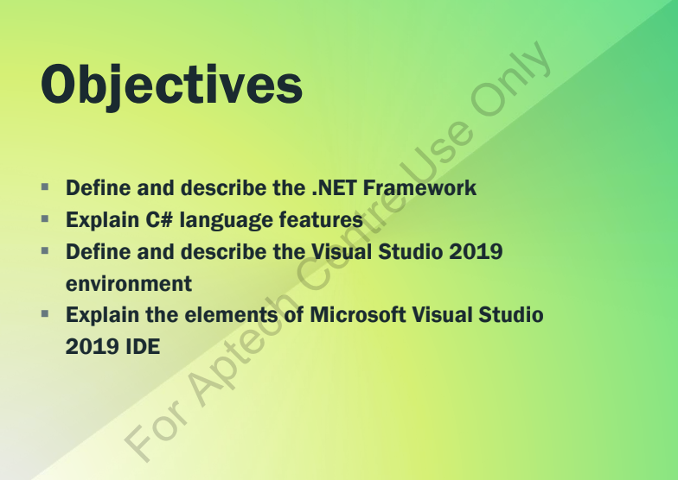

Slide 2


Slide 3



Slide 4
.NET is a framework to develop software applications.
It is designed and developed by Microsoft and the first beta version released in 2000.
It is used to develop applications for web, Windows, phone. Moreover, it provides a broad range of functionalities and support.
This framework contains a large number of class libraries known as Framework Class Library (FCL).
The software programs written in .NET are executed in the execution environment, which is called CLR (Common Language Runtime). These are the core and essential parts of the .NET framework.
This framework provides various services like memory management, networking, security, memory management, and type-safety.

Slide 5
The .NET Framework supports more than 60 programming languages such as C#, F#, VB.NET, J#, VC++, JScript.NET, APL, COBOL, Perl, Oberon, ML, Pascal, Eiffel, Smalltalk, Python, Cobra, ADA, etc.
Following is the .NET framework Stack that shows the modules and components of the Framework.

Slide 6
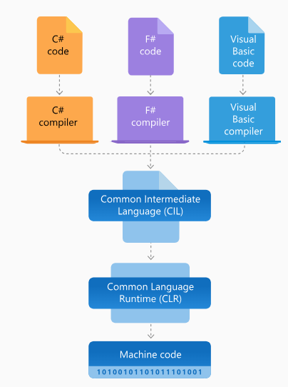

Slide 7


Slide 8
C# is a simple, modern, general-purpose, object-oriented programming language developed by Microsoft that runs on .NET Framework. led by Anders Hejlsberg
C# is a programming language of .NET Framework.
C# (pronounced "C sharp") is widely used for developing different applications, including desktop, web, mobile, cloud, and gaming applications. C# enables developers to build secure and robust.NET applications. Programmers who are familiar with C, C++, Java, and JavaScript can easily understand and work with C# because it adopts basics of C and object oriented programming languages.

Slide 9
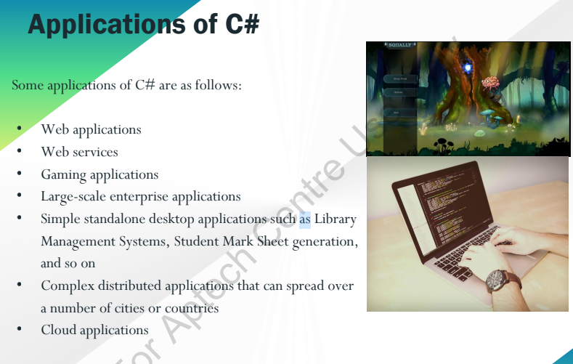

Slide 10


Slide 11
C# is pronounced as "C-Sharp". It is an object-oriented programming language provided by Microsoft that runs on .NET Framework.
Anders Hejlsberg is known as the founder of C# language.
It is based on C++ and Java, but it has many additional extensions used to perform component oriented programming approach.
C# has evolved much since their first release in the year 2002. It was introduced with .NET Framework 1.0 and the current version of C# is 5.0.

Slide 12
